Slide 1
AI PM TRACK · TAKE-HOME · TRACK A
Zycus Contract
Authoring Agent
14/14
SCENARIOS PASS LIVE
3/3
An AI agent that drafts a Mutual NDA from raw business inputs — auto-fills what it's confident about, and routes anything that shifts legal risk to a human before it ever reaches the document.
PLANTED ISSUES CAUGHT
✓
Affiliate carve-out — flagged, not silently inserted
~6.8s
✓
Payment terms on an NDA — recognized N/A, omitted
AVG. LIVE LATENCY
✓
“Use today’s date” — resolved, never left literal
LIVE PRODUCT
REPOSITORY
zycus-blond.vercel.app
github.com/Flukeshotz/Zycus
ZYCUS CONTRACT AUTHORING AGENT
1

Slide 2
Architecture
Code decides what's correct. The LLM only decides what needs judgment.
Browser SPA
FastAPI on Vercel
POST /api/run · maxDuration 60s
DETERMINISTIC LAYER
MULTI-MODEL LLM LAYER (GROQ)
Template Store · Rulebook · Clause Library
Normalizer · gpt-oss-20b
YAML, loaded once, never edited by the model
strict JSON — interprets every field, flags ambiguity
Field Mapper → Rule Engine
Clause Analyst · gpt-oss-120b
term/survival ranges · governing-law allowlist · party checks
Phase A: tool loop (get_rules, search_clause_library,
get_template_section, max 6 calls) → evidence pack
Phase B: strict-JSON decision from evidence only
Confidence Router — Gates G1–G11
first match wins — the whole flag-vs-act decision lives here
Verifier · qwen3.8-27b
QA Gate — Q1–Q8
checks required safeguards are present before trusting text
8 mechanical checks scan every render before download unlocks
Fallback · gemini-3.5-flash
auto-enabled — one retry on a Groq 429 / 5xx / timeout
Assembler & Signer
RenderedDoc → .docx (python-docx, comments) + HTML preview — HMAC-SHA256 signed envelope
POST /api/render — reviewer actions → verify signature → re-render → re-QA — ZERO new LLM calls
ZYCUS CONTRACT AUTHORING AGENT
2

Slide 3
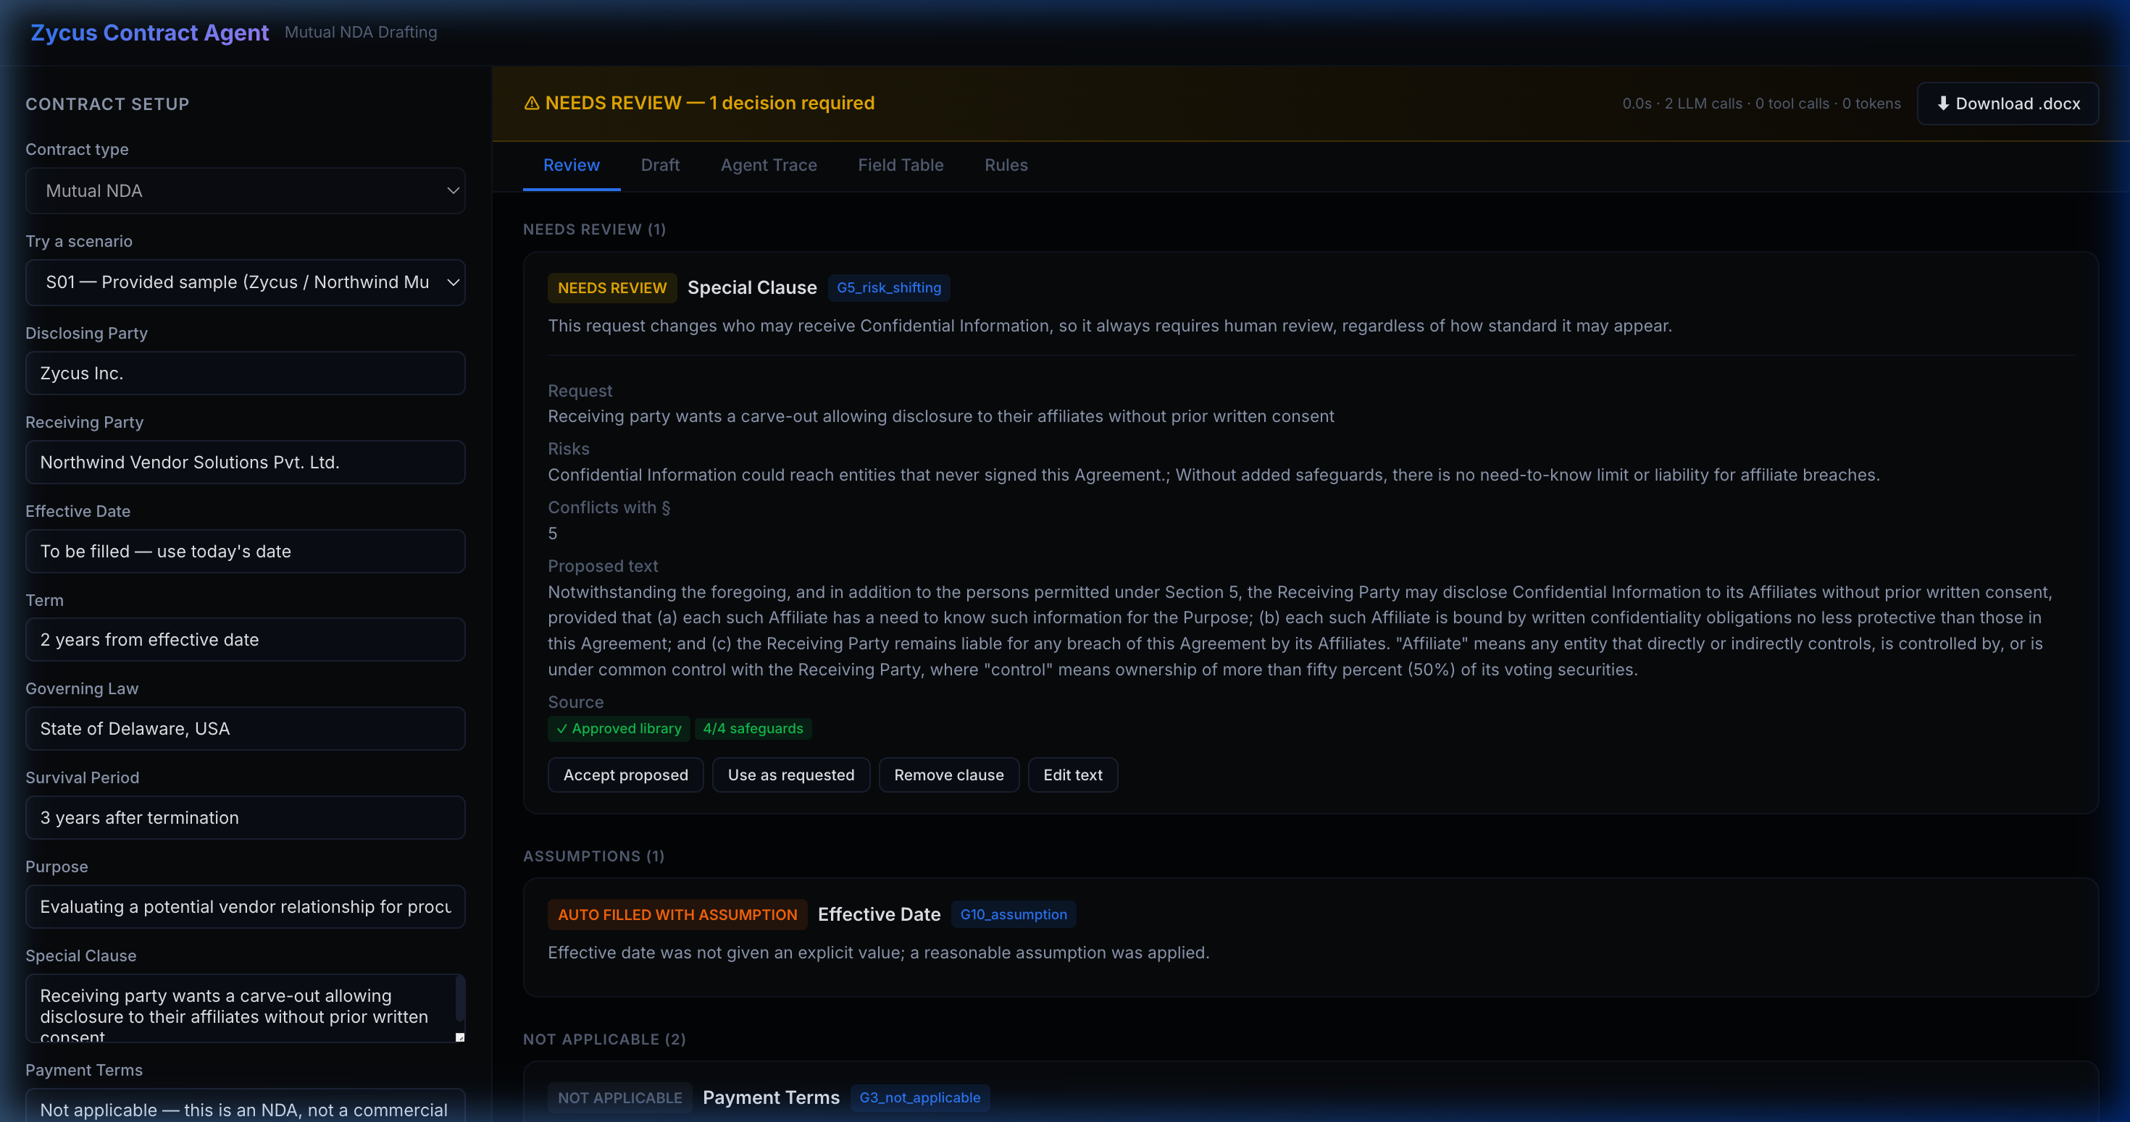
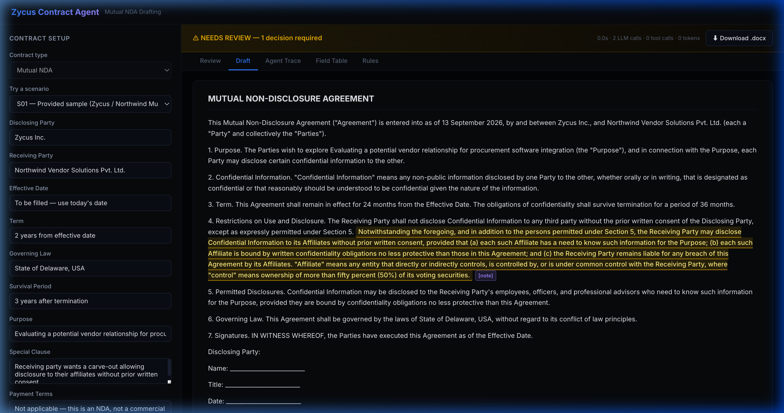
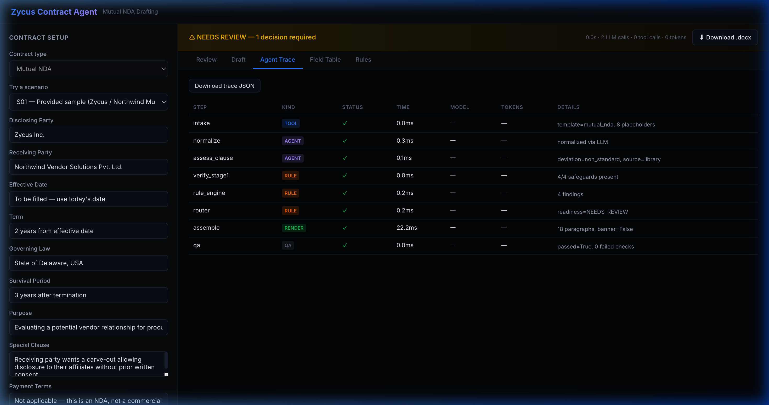
Product Walkthrough
Real working screens — the S01 sample run, live on Groq
① Review — HITL decisions
② Draft — rendered preview
③ Agent Trace — full audit log
Status · gate · reason · 4 one-click actions per flagged clause
Same RenderedDoc that produces the .docx — preview can't drift from the file
Every step, tool call, model, latency, tokens, and rate-limit headroom
ZYCUS CONTRACT AUTHORING AGENT
3

Slide 4
What Broke — and How I Fixed It
Real bugs from docs/DEBUG_LOG.md — not staged, not hypothetical
!
QA Gate false-failed on every BLOCKED document
Symptom S02 (missing governing law) failed the docx round-trip check Q8, even though the rendered document itself was completely correct.
Fix write_docx() rendered [banner, title, body]; RenderedDoc.full_text built [title, banner, body] — the two disagreed only when a banner existed. Reordered full_text to match the writer exactly.
!
Live model leaked its own prompt instruction into the document
Symptom The Normalizer was told “don't guess an actual date, the caller resolves it” for a derived effective_date — and complied, correctly, by returning null. Nothing was actually acting as “the caller.”
Fix Added an unconditional deterministic canonicalization step after every normalize() call — live or offline — so “today” is always resolved the same way, regardless of what the model returns.
!
Groq free-tier rate limits during rapid sequential evals
Symptom Back-to-back live scenario runs depleted the 8,000-tokens/min bucket; remaining headroom dipped to 32–42 tokens on complex multi-step scenarios.
Fix Graduated backoff in evals/run.py, reading x-ratelimit-remaining-tokens between runs — 6/6 must-pass scenarios then passed ×2 repeats with zero flakiness and zero 429s.
ZYCUS CONTRACT AUTHORING AGENT
4

Slide 5
Flag vs. Act
Where an autonomous agent draws the line on a legal document
✓
Acts autonomously
!
Always flags for a human
•
Resolving standard durations (“2 years” → 24 months)
•
Risk-shifting clauses (G5) — any carve-out or liability change, however standard it looks
•
Missing required terms (G1) — red ⟦MISSING⟧ marker, document BLOCKED
•
Converting “today” into an unambiguous, jurisdiction-correct date
•
Non-approved governing law (G6) — e.g. Singapore isn't on the list
•
Omitting commercial fields that don't apply to an NDA
•
Unrecognized or identical parties (G6) — neither is a known Zycus entity
•
Matching a request to an approved clause-library entry
•
AI outage (G7) — safe degraded draft, never a guess
“Gate G5 always wins for a special clause — confidence can never override it.”
An unnecessary review costs about a minute. An unreviewed affiliate carve-out can hand confidential information to entities that never signed the agreement. That asymmetry is the whole decision.
ZYCUS CONTRACT AUTHORING AGENT
5

Slide 6
Evals, Limitations & Roadmap
14 scenarios, written before the code, graded on exact status — not “looks right”
3/3
3/3
4/4
3/3
1/1
Standard baseline
Planted flaws
Missing & ambiguous
Boundary violations
Resilience / fallback
S01, S06, S11
S01, S05, S08
S02, S04, S09, S10
S03, S12, S13
S14
Overall: 14/14 (100%) · Must-pass: 6/6 × 2 repeats, zero flakiness · ~6.8s avg. live latency
LIMITATIONS
NEXT STEPS
–
Groq free-tier: 8K tokens/min — sequential evals need pacing
–
Visual redline diff between request and library fallback
–
Scope: Mutual NDAs only (Delaware-style standard)
–
CRM/CLM intake (Salesforce, HubSpot) → Zycus iContract export
–
Rulebook positions are illustrative, not certified legal counsel
–
Expand templates: MSAs, SOWs, DPA addenda
Live: zycus-blond.vercel.app · Repo: github.com/Flukeshotz/Zycus · Deck: /deck.html
ZYCUS CONTRACT AUTHORING AGENT
6

